Slide 1
DYNAMIC PROGRAMMING
Nama Kelompok:
Asep Ridwan Hidayat – Rizki Satriawan Sudarsono – Imam Satria Hanggara

Slide 2
Contents of This Template
Here’s what you’ll find in this Slidesgo template:
A slide structure based on a consulting sales pitch, which you can easily adapt to your needs. For more info on how to edit the template, please visit Slidesgo School or read our FAQs.
An assortment of illustrations that are suitable for use in the presentation can be found in the alternative resources slide.
A thanks slide, which you must keep so that proper credits for our design are given.
A resources slide, where you’ll find links to all the elements used in the template.
Instructions for use.
Final slides with:
The fonts and colors used in the template.
A selection of illustrations. You can also customize and animate them as you wish with the online editor. Visit Stories by Freepik to find more.
More infographic resources, whose size and color can be edited.
Sets of customizable icons of the following themes: general, business, avatar, creative process, education, help & support, medical, nature, performing arts, SEO & marketing, and teamwork.
You can delete this slide when you’re done editing the presentation.

Slide 3
01
Company
Enter a subtitle here if you need it

Slide 4
Our Solutions
Mercury
Venus
01
02
Mercury is the closest planet to the sun
Venus is the second planet from the sun
Jupiter
Neptune
03
04
Jupiter is the biggest planet of them all
Neptune is the farthest planet from the Sun

Slide 5

—Someone Famous
“This is a quote, words full of wisdom that someone important said and can make the reader get inspired.”

Slide 6
Our Consultants
John James
Venus is the second planet from the Sun
Jane Patterson
Joe Doe
Mercury is the closest planet to the Sun
Neptune is the farthest planet from the Sun

Slide 7
498,300,000
Big numbers catch your audience’s attention

Slide 8

A Picture Is Worth a Thousand Words

Slide 9
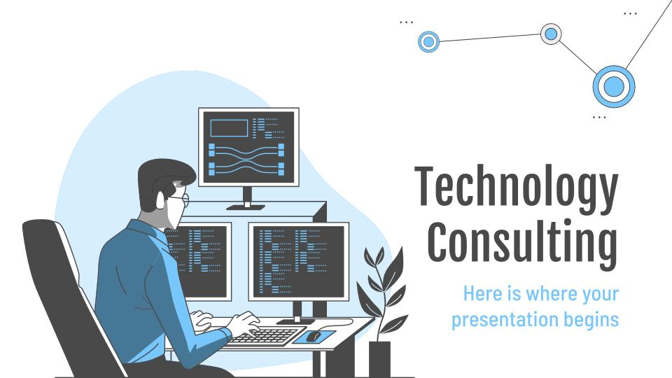
Desktop Software
You can replace the image on
the screen with your own
work. Just delete this one,
add yours and center it properly

Slide 10
Alternative Resources
Find more illustrations like these on Stories by Freepik

Slide 11
Storyset
Create your Story with our illustrated concepts. Choose the style you like the most, edit its colors, pick the background and layers you want to be visible and bring them to life with the animator panel. It will boost your presentation for sure! Check out how it works.
Pana
Amico
Bro
Rafiki

